Slide 1

Introduction: Overview of Data Structures
Data Structure | Introduction to Data Structure
Course: Data Structure (25CSH-209) | Chapter: Introduction to Data Structure | Program: Bachelor of Technology (Core+DS+CC+CY+IT)
DISCOVER · LEARN · EMPOWER
Notes:
Welcome everyone to our Data Structure course. Today we begin with the fundamental chapter on Introduction to Data Structures. As Chandigarh University students, you are here to Discover, Learn, and Empower yourself with these critical computing skills. Let us dive straight into the core concepts that will shape your programming logic.

Slide 2
Course Outcomes
SLIDE 2 / 10
Course Outcome
CO | BT LEVEL | DESCRIPTION
CO1 | BT1 | Understand and apply basic data structures, algorithms, complexity analysis, ADTs, arrays and linked lists.
CO2 | BT2 | Apply and implement stacks and queues in problem-solving.
CO3 | BT3 | Analyse and apply searching, sorting, and hashing techniques.
CO4 | BT4 | Construct and apply tree structures and traversal techniques.
CO5 | BT5 | Represent and solve graph problems using DFS, BFS, and graph algorithms.
Chandigarh University
2 / 10
Notes:
Our primary goal for this lecture is to align with Course Outcome 1. By the end of this session, you will understand and apply basic data structures, algorithms, complexity analysis, ADTs, arrays and linked lists. This outcome forms the bedrock for all subsequent chapters in our syllabus. Please note this specific outcome as it guides our entire learning path.

Slide 3
Learning Objectives
SLIDE 3 / 10
Learning Outcomes
1
Define data structures and their role in organizing computer data.
2
Distinguish between primitive and non-primitive data structures clearly.
3
Identify the basic operations performed on data structures effectively.
4
Explain the importance of data structures in algorithm efficiency.
Chandigarh University
3 / 10
Notes:
By the end of this lecture, you will be able to define data structures and their role in organizing computer data. You will also distinguish between primitive and non-primitive data structures clearly. We will identify the basic operations performed on data structures effectively. Finally, you will explain the importance of data structures in algorithm efficiency.

Slide 4
Lecture
SLIDE 4 / 10
Definition and Purpose
1
A data structure is a specialized format for organizing and storing data.
2
It defines the relationship between data elements for efficient access.
3
Proper structure reduces memory usage and improves processing speed.
4
It acts as a blueprint for writing efficient algorithms and programs.
Chandigarh University
4 / 10
Notes:
Think of a data structure as a specialized format for organizing and storing data. It defines the relationship between data elements for efficient access, much like a library catalog. Without it, finding a specific book in a pile of thousands would be impossible. Proper structure reduces memory usage and improves processing speed significantly.

Slide 5
Classification
SLIDE 5 / 10
Primitive vs Non-Primitive
1
Primitive data structures are directly operated upon by machine instructions.
2
Examples include integers, floats, characters, and boolean values.
3
Non-primitive structures are derived from primitive types for complexity.
4
They include arrays, lists, stacks, queues, trees, and graphs.
Chandigarh University
5 / 10
Notes:
We classify data structures into two main categories: primitive and non-primitive. Primitive data structures are directly operated upon by machine instructions like integers and floats. Non-primitive structures are derived from primitive types for complexity, such as arrays. They include lists, stacks, queues, trees, and graphs which handle large datasets.

Slide 6
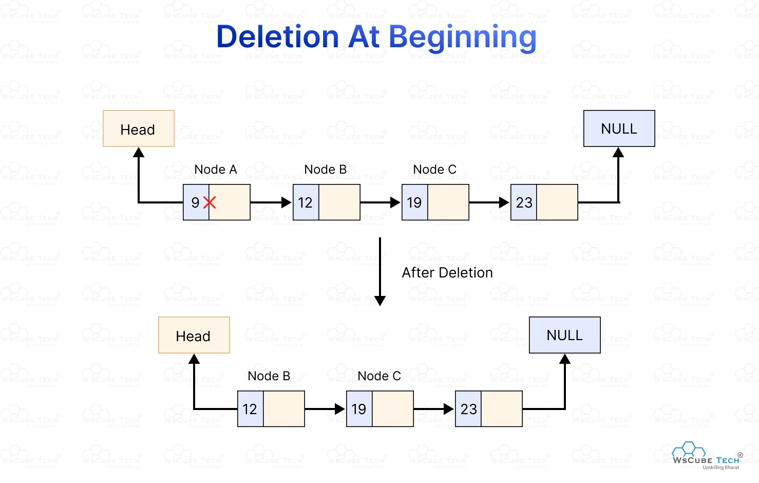
Lecture
SLIDE 6 / 10
Basic Operations Overview
1
Traversal involves accessing each element of the data structure once.
2
Insertion adds a new element at a specific position within the structure.
3
Deletion removes an existing element from the data structure.
4
Searching finds the location of a specific element within the structure.
Source: deen3evddmddt.cloudfront.net
Chandigarh University
6 / 10
Notes:
Every data structure supports a set of basic operations that define its utility. Traversal involves accessing each element of the data structure once to process it. Insertion adds a new element at a specific position within the structure. Deletion removes an existing element, while searching finds the location of a specific element.

Slide 7
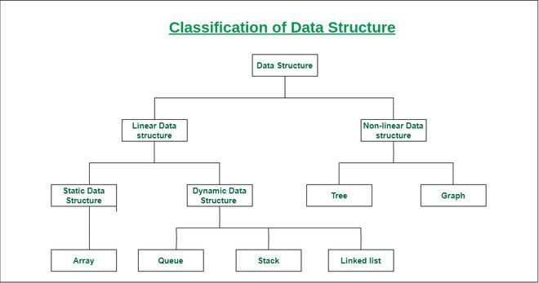
Lecture
SLIDE 7 / 10
Abstract Data Types (ADT)
1
An ADT defines a set of data and operations without implementation details.
2
It separates the logical properties from the physical implementation.
3
Common examples include Stack, Queue, List, and Set.
4
ADTs allow programmers to focus on what rather than how.
Data Structure Types, Classifications and Applications - GeeksforGeeks (source: media.geeksforgeeks.org)
Chandigarh University
7 / 10
Notes:
An Abstract Data Type defines a set of data and operations without implementation details. It separates the logical properties from the physical implementation, acting as a contract. Common examples include Stack, Queue, List, and Set. ADTs allow programmers to focus on what rather than how the data is stored.

Slide 8
Lecture
SLIDE 8 / 10
Time Complexity Concept
1
Time complexity measures the execution time relative to input size.
2
It is denoted using Big O notation like O(n) or O(1).
3
O(1) represents constant time regardless of input size.
4
O(n) represents linear time proportional to the number of elements.
Chandigarh University
8 / 10
Notes:
Time complexity measures the execution time relative to input size, crucial for efficiency. It is denoted using Big O notation like O(n) or O(1). O(1) represents constant time regardless of input size, like accessing an array index. O(n) represents linear time proportional to the number of elements, like scanning a list.

Slide 9
Lecture
SLIDE 9 / 10
Key Takeaways
1
Data structures organize data to enable efficient algorithm execution.
2
Primitive types are basic, while non-primitive types are derived structures.
3
Core operations include traversal, insertion, deletion, and searching.
4
ADTs define behavior without specifying implementation details.
5
Time complexity analysis determines the efficiency of operations.
Chandigarh University
9 / 10
Notes:
To summarize, data structures organize data to enable efficient algorithm execution. Primitive types are basic, while non-primitive types are derived structures like arrays. Core operations include traversal, insertion, deletion, and searching. ADTs define behavior without specifying implementation details, and time complexity analysis determines the efficiency of operations.

Slide 10
Lecture
SLIDE 10 / 10
References
DATA STRUCTURES
A Pseudocode Approach with C — Gilberg, Forouzan
• Data Structures — Lipschutz
• Data Structure Using C — AK Sharma
• C and Data structure — P. S. Deshpandey
Chandigarh University
10 / 10
Notes:
For further reading, please refer to the standard textbooks listed on this slide. Data Structures: A Pseudocode Approach with C by Gilberg and Forouzan is an excellent resource. Data Structures by Lipschutz and Data Structure Using C by AK Sharma are also highly recommended. Finally, C and Data structure by P. S. Deshpandey provides additional practical insights.

